Slide 1
TACL 2026
12th International Conference on Topology, Algebra, and Categories in Logic
A Unified Categorical Duality for Preminimal Negation and Beyond
Extending Compatibility Semantics Along Dunn’s Negation Hierarchy
Arun Kumar · Neha Gaur* · Bisham Dewan
Department of Mathematics, Institute of Science, Banaras Hindu University, Varanasi, India
27–31 July 2026 · Kraków, Poland
Jagiellonian University

Slide 2
01
Foundations
A short history of preminimal negation, and where it sits in Dunn’s kite.

Slide 3
A SHORT HISTORY
Preminimal negation and its logic
1974 — Goldblatt
orthoframes and an incompatibility relation ⊥ give the first relational reading of a non-classical negation.
Kᵢ is the minimal negative modal logic with a perp semantics — order-reversal, and nothing else.
TACL 2026

Slide 4
A SHORT HISTORY
Preminimal negation and its logic
1974 — Goldblatt
orthoframes and an incompatibility relation ⊥ give the first relational reading of a non-classical negation.
1993 — Dunn, “Star and Perp”
negation as impossibility: ∼A holds at x iff no C-compatible state verifies A. The weakest negation satisfying only contraposition is called subminimal.
Kᵢ is the minimal negative modal logic with a perp semantics — order-reversal, and nothing else.
TACL 2026

Slide 5
A SHORT HISTORY
Preminimal negation and its logic
1974 — Goldblatt
orthoframes and an incompatibility relation ⊥ give the first relational reading of a non-classical negation.
1993 — Dunn, “Star and Perp”
negation as impossibility: ∼A holds at x iff no C-compatible state verifies A. The weakest negation satisfying only contraposition is called subminimal.
2005 — Dunn & Zhou
subminimal negation is renamed preminimal; its logic Kᵢ is shown to have a perp (compatibility) semantics — the base case for the whole hierarchy.
Kᵢ is the minimal negative modal logic with a perp semantics — order-reversal, and nothing else.
TACL 2026

Slide 6
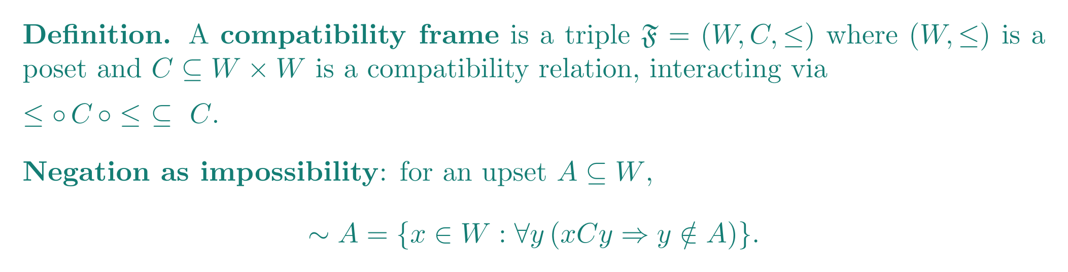
RELATIONAL SIDE
Compatibility frames
Reading the frame
xCy reads: y is a “compatible” situation relative to x — not a successor, a co-consistent alternative.
A holds nowhere among x’s compatible situations exactly when ∼A holds at x.
TACL 2026

Slide 7
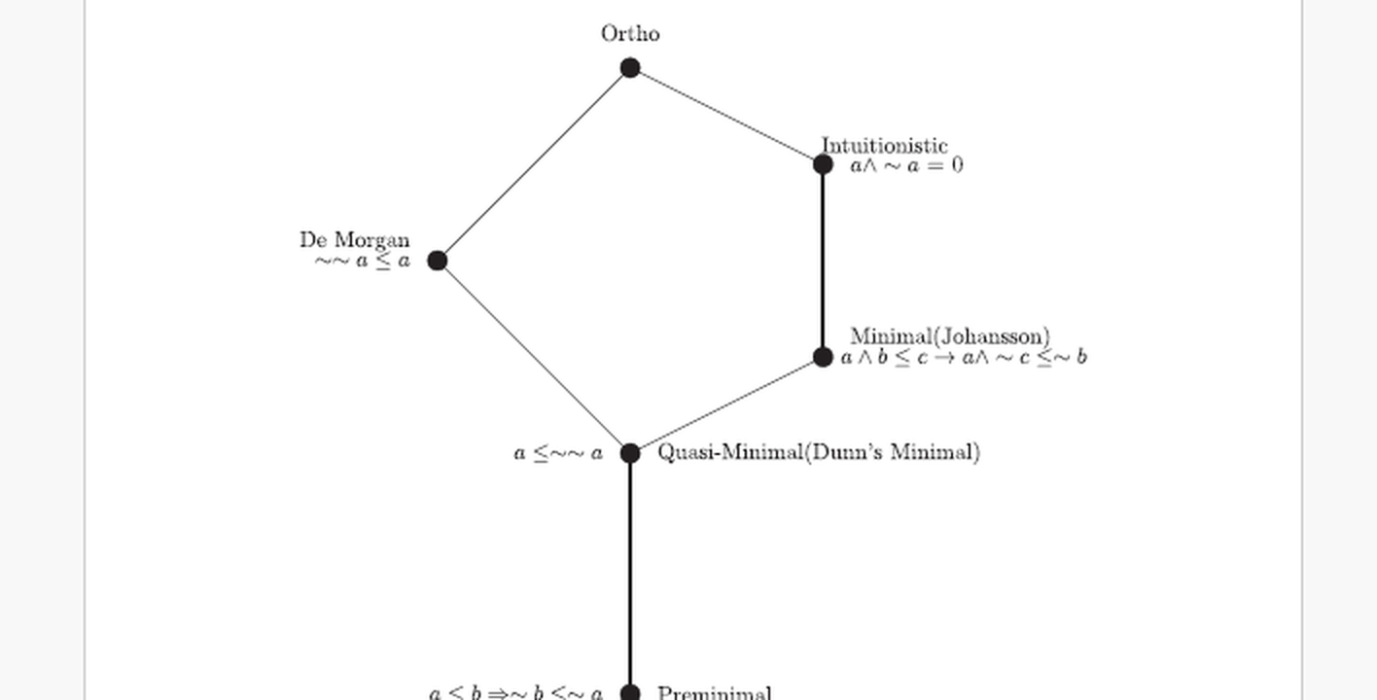
DUNN’S GENERALIZATION
Dunn’s kite of negations
Dunn (1996, “Generalized ortho negation”) shows that adding one axiom at a time to preminimal negation climbs a fixed hierarchy — each step a further first-order condition on C.
TACL 2026

Slide 8
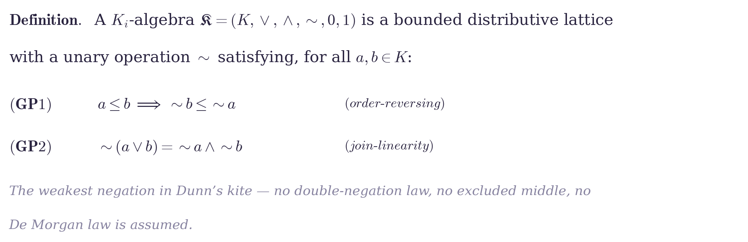
ALGEBRAIC SEMANTICS OF Kᵢ LOGIC
Kᵢ-algebras
Why start here?
Kᵢ-algebras are the algebraic counterpart of the weakest system in Dunn’s kite.
TACL 2026

Slide 9
ALGEBRAIC SEMANTICS OF Kᵢ LOGIC
Kᵢ-algebras
Why start here?
Kᵢ-algebras are the algebraic counterpart of the weakest system in Dunn’s kite.
Every stronger negation system studied later (De Morgan, Kleene, Stone, orthocomplemented, regular double Stone) is obtained by adding axioms to this base.
TACL 2026

Slide 10
ALGEBRAIC SEMANTICS OF Kᵢ LOGIC
Kᵢ-algebras
Why start here?
Kᵢ-algebras are the algebraic counterpart of the weakest system in Dunn’s kite.
Every stronger negation system studied later (De Morgan, Kleene, Stone, orthocomplemented, regular double Stone) is obtained by adding axioms to this base.
A full categorical duality for Kᵢ-algebras therefore gives a uniform starting point for the whole hierarchy.
TACL 2026

Slide 11
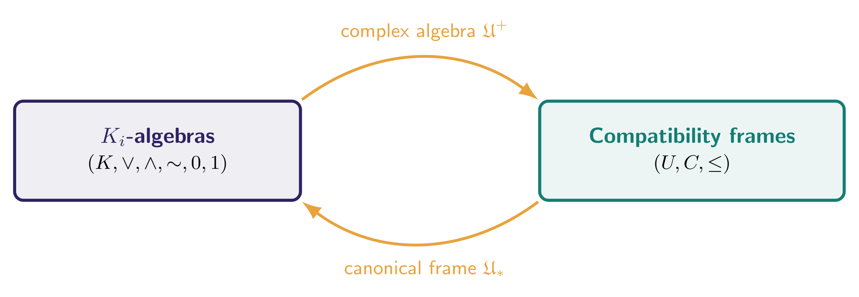
WHERE WE START
Discrete duality, and how it is built
Complex algebra 𝔘⁺
Take the upsets of (W,≤), ordered by ⊆, with ∪, ∩ as meet/join and ∼ defined pointwise from C.
TACL 2026

Slide 12
WHERE WE START
Discrete duality, and how it is built
Complex algebra 𝔘⁺
Canonical frame 𝔘ₓ
Take the upsets of (W,≤), ordered by ⊆, with ∪, ∩ as meet/join and ∼ defined pointwise from C.
Take prime filters of the algebra as points; ≤ is ⊆, and x C y holds when the filters cannot be jointly extended past the negation.
TACL 2026

Slide 13
PROBLEM STATEMENT
Questions this work answers
1
What relational structures are categorically dual to Kᵢ-algebras?
This talk answers all three — the categorical duality, its topological alignment, and its extension.
TACL 2026

Slide 14
PROBLEM STATEMENT
Questions this work answers
1
What relational structures are categorically dual to Kᵢ-algebras?
2
Does this dual correspond to existing topological duals (Celani’s ¬-spaces)?
This talk answers all three — the categorical duality, its topological alignment, and its extension.
TACL 2026

Slide 15
PROBLEM STATEMENT
Questions this work answers
1
What relational structures are categorically dual to Kᵢ-algebras?
2
Does this dual correspond to existing topological duals (Celani’s ¬-spaces)?
3
Can the duality be extended along Dunn’s negation hierarchy, with each negation system characterized on the frame side?
This talk answers all three — the categorical duality, its topological alignment, and its extension.
TACL 2026

Slide 16
02
The Core Duality
Partial bounded morphisms, descriptive frames, and the main dual-equivalence theorem.

Slide 17
WHERE MORPHISMS COME FROM
Morphisms for lattices with operators
Goldblatt
introduced a first-order notion of morphism between polarity-based relational structures dual to bounded distributive lattices with operators — generalizing bounded morphisms from Boolean modal logic to this broader, non-Boolean setting.
Partial bounded morphisms specialize this general theory to the single unary operator ∼ on compatibility frames.
TACL 2026

Slide 18
WHERE MORPHISMS COME FROM
Morphisms for lattices with operators
Goldblatt
introduced a first-order notion of morphism between polarity-based relational structures dual to bounded distributive lattices with operators — generalizing bounded morphisms from Boolean modal logic to this broader, non-Boolean setting.
Sofronie-Stokkermans
further developed Priestley-style duality and canonical extensions for bounded distributive lattices with well-behaved operators, connecting algebraic and Kripke-style models (Studia Logica, 2000, Parts I & II).
Partial bounded morphisms specialize this general theory to the single unary operator ∼ on compatibility frames.
TACL 2026

Slide 19
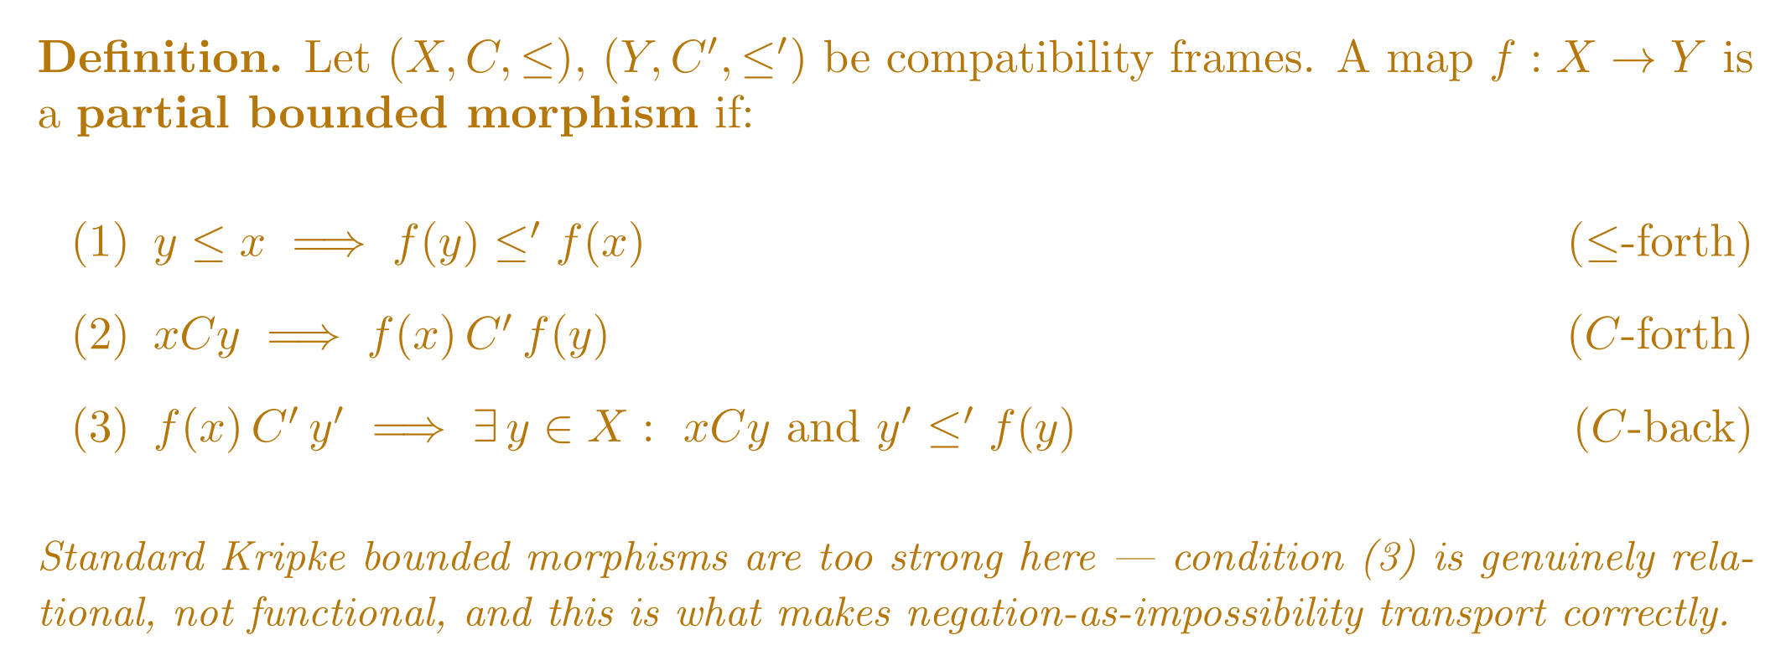
THE KEY DEFINITION
Partial bounded morphisms
TACL 2026

Slide 20
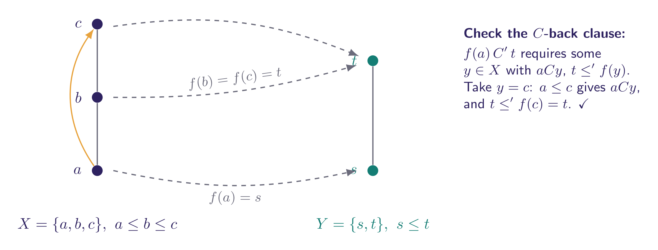
SEEING IT WORK
A worked example
The (C)-back clause is genuinely relational: f(a) can be C′-related to a point y′ that is not itself in the image of f, so long as some C-successor of a maps above y′.
TACL 2026

Slide 21
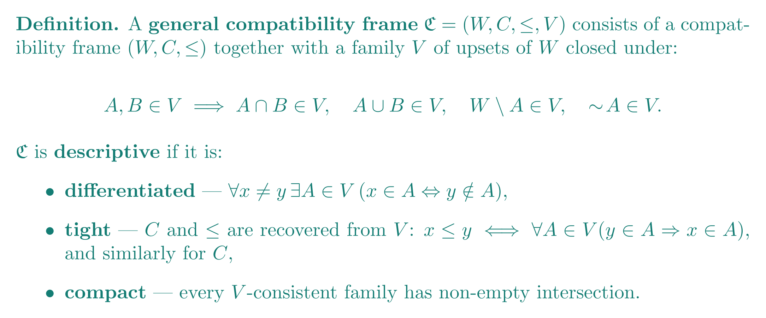
SHARPENING THE FRAME SIDE
Descriptive compatibility frames
This is the exact analogue of descriptive general frames in modal logic — the extra structure needed so that the algebra/frame passage is a genuine equivalence, not just an embedding.
TACL 2026

Slide 22
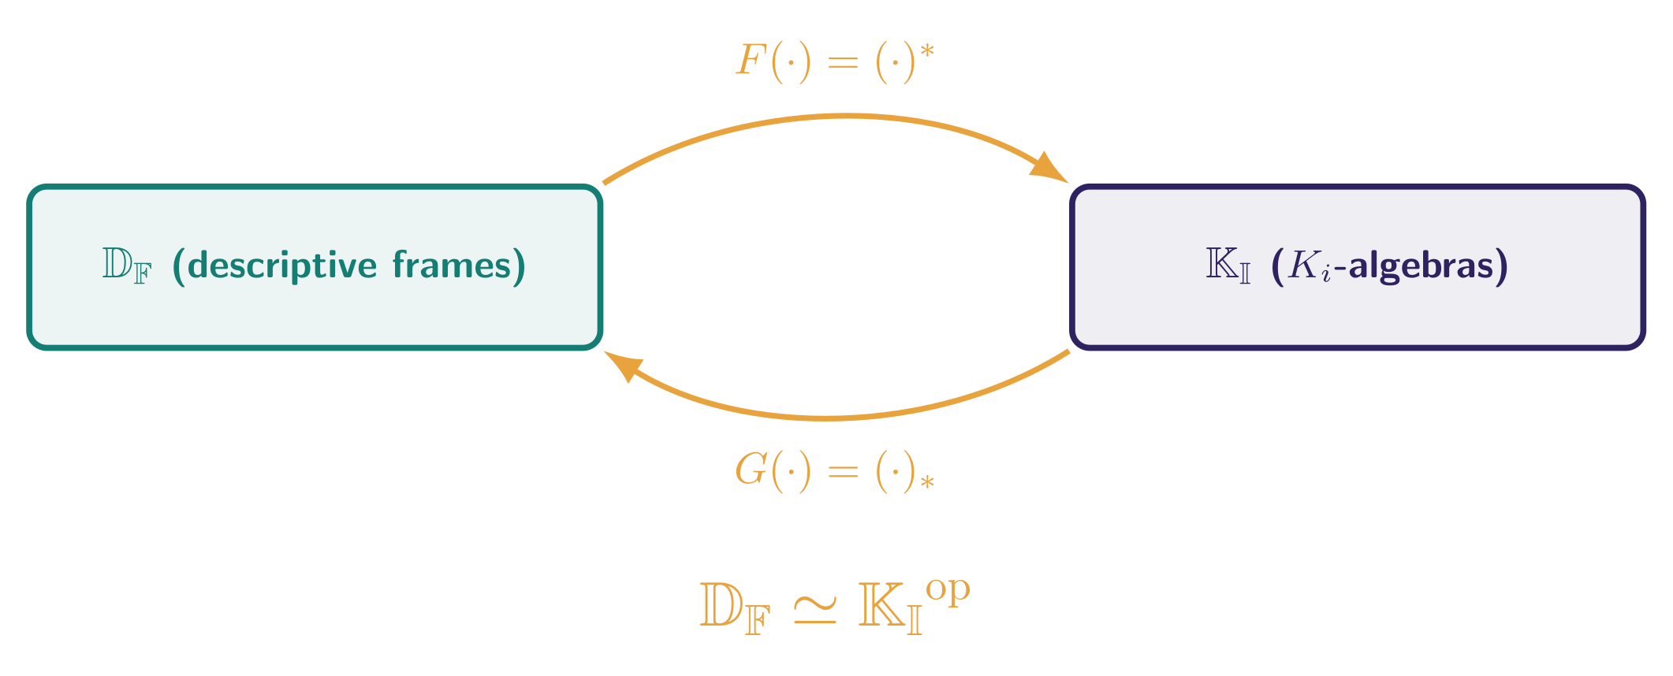
HOW THE TWO SIDES TALK TO EACH OTHER
Morphisms interchange between the categories
A partial bounded morphism β induces a Kᵢ-homomorphism β⁺ in the reverse direction, and every Kᵢ-homomorphism η induces a partial bounded morphism η₊ back — contravariantly, on the nose.
TACL 2026

Slide 23
CONSISTENCY CHECK
Aligning with Celani’s ¬-spaces
Celani (1999)
topologized distributive lattices with a negation operator — the established dual spaces for this signature.
TACL 2026

Slide 24
CONSISTENCY CHECK
Aligning with Celani’s ¬-spaces
Celani (1999)
topologized distributive lattices with a negation operator — the established dual spaces for this signature.
This work
descriptive compatibility frames, built from an explicitly relational (impossibility) semantics.
TACL 2026

Slide 25
CONSISTENCY CHECK
Aligning with Celani’s ¬-spaces
Celani (1999)
topologized distributive lattices with a negation operator — the established dual spaces for this signature.
This work
descriptive compatibility frames, built from an explicitly relational (impossibility) semantics.
Result
the two constructions embed into one another compatibly — our frames sit inside established duality theory rather than beside it.
TACL 2026

Slide 26
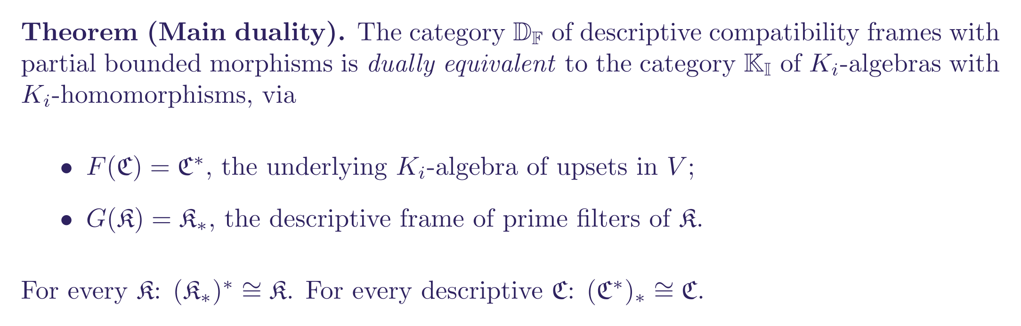
MAIN RESULT
The dual equivalence

Slide 27
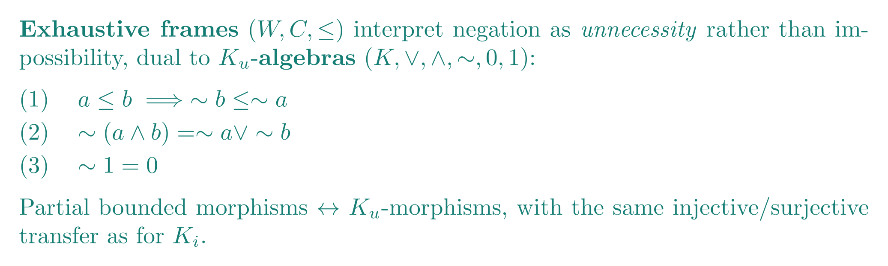
EXTENDING THE HIERARCHY — BRANCH 1
Impossibility vs. unnecessity
Compatibility frames read negation as impossibility: ∼A true where A is nowhere compatible.
Exhaustive frames read it as unnecessity, dual to Kᵤ-algebras — the same partial bounded morphism machinery carries over.
TACL 2026

Slide 28
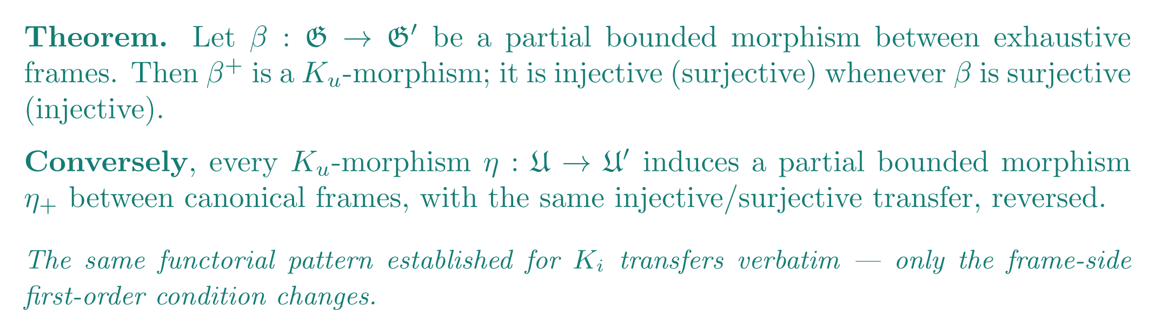
EXTENDING THE HIERARCHY — BRANCH 1
Duality for Kᵤ-algebras
Same functor, same natural isomorphisms — only the first-order frame condition defining “exhaustive” differs from “compatibility.”
TACL 2026

Slide 29
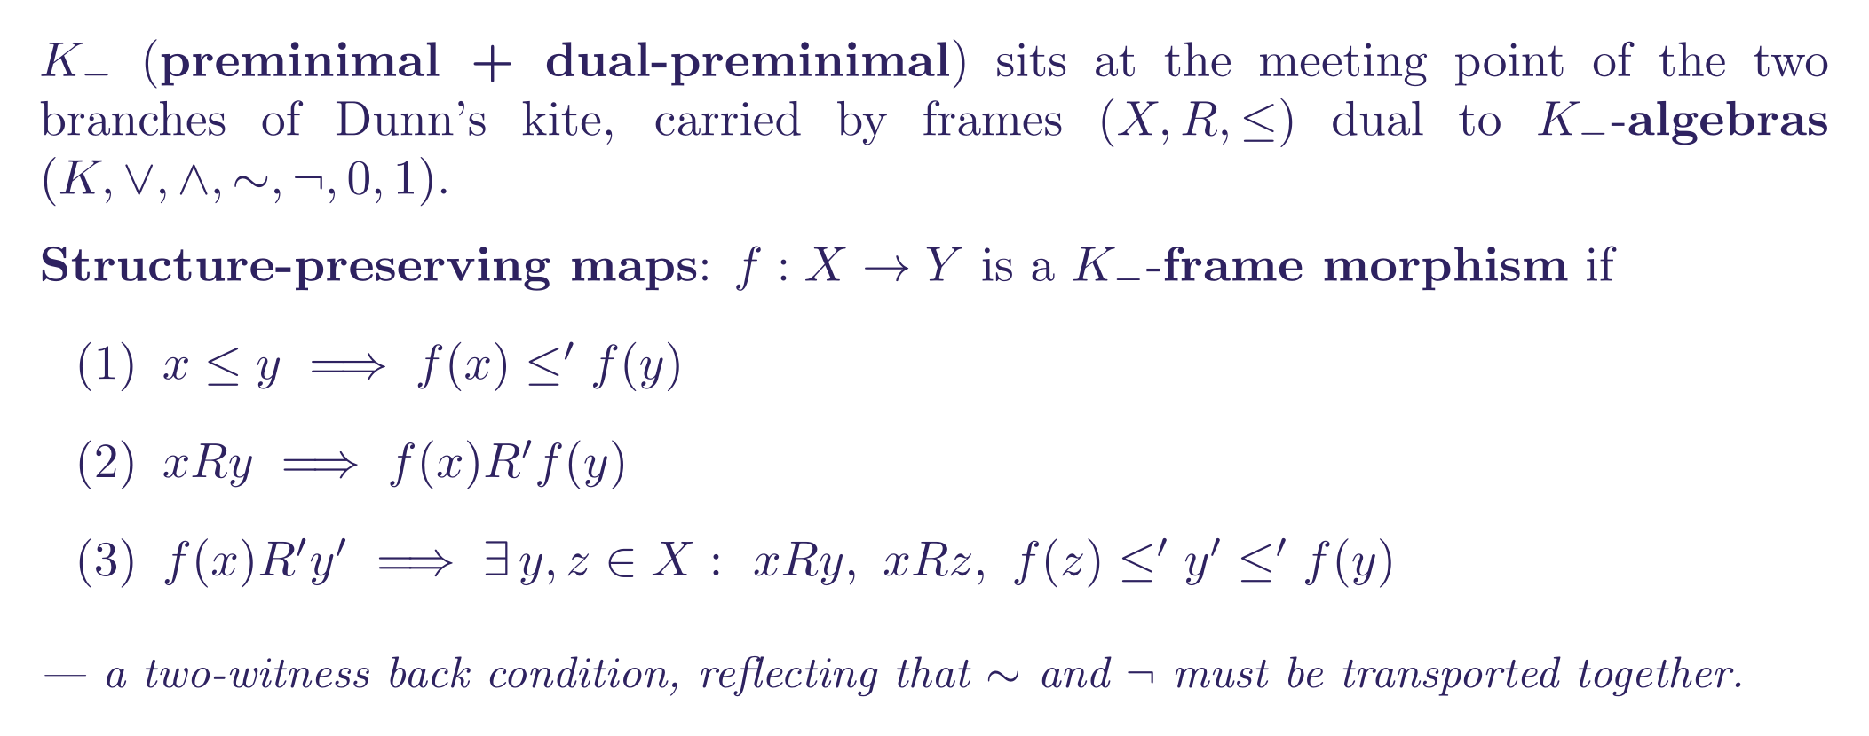
EXTENDING THE HIERARCHY — BRANCH 2
K₋: reuniting the two branches
TACL 2026

Slide 30
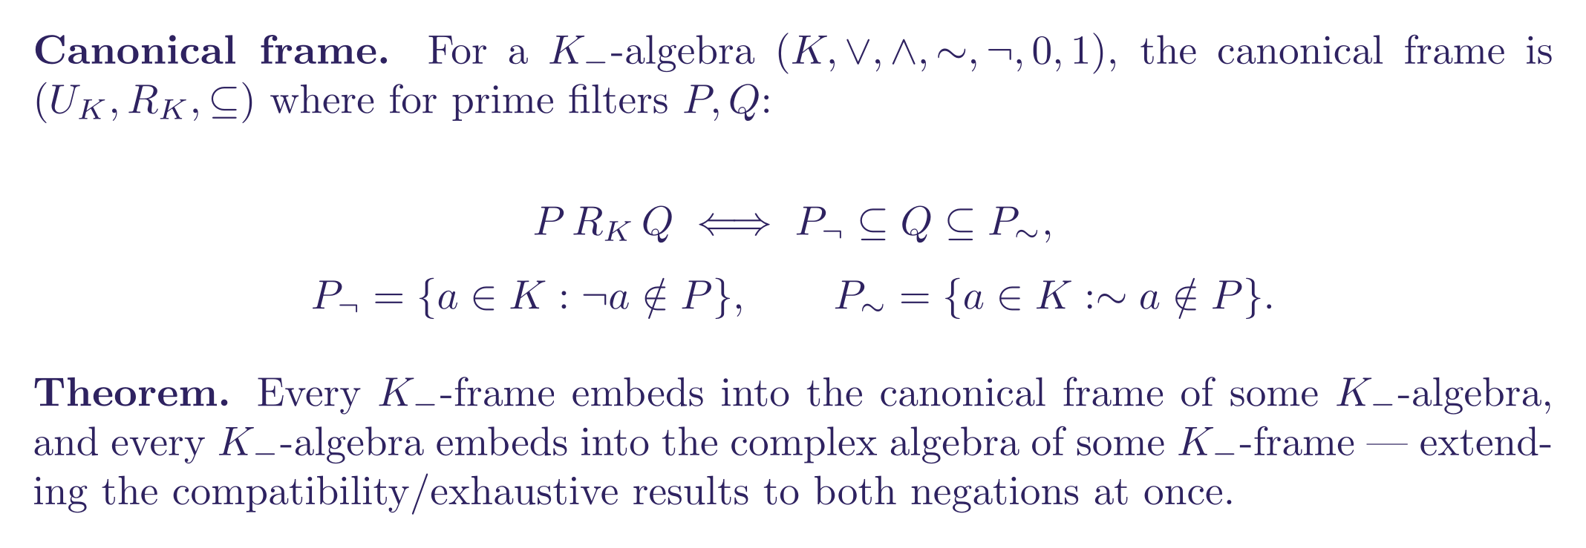
EXTENDING THE HIERARCHY — BRANCH 2
Canonical frames for K₋-algebras
TACL 2026

Slide 31
04
Extension for Stronger Negations
Every algebraic axiom that climbs the kite has a matching first-order condition on C.

Slide 32
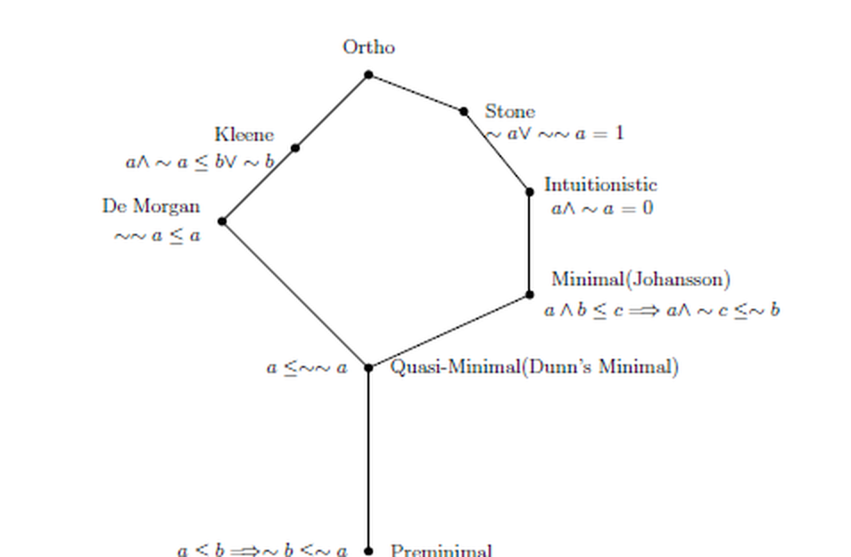
CHARACTERIZING NEGATIONS ON FRAMES
From algebraic axioms to first-order frame conditions
The general schema
Just as Sahlqvist axioms correspond to first-order conditions on Kripke frames, each strengthening of ∼ that climbs the kite corresponds to a first-order condition on C.
TACL 2026

Slide 33
CHARACTERIZING NEGATIONS ON FRAMES
From algebraic axioms to first-order frame conditions
The general schema
Just as Sahlqvist axioms correspond to first-order conditions on Kripke frames, each strengthening of ∼ that climbs the kite corresponds to a first-order condition on C.
What follows
De Morgan, Kleene, pseudocomplemented (Pₛ), Stone, and ortho negation each pinned down by an explicit ∀/∃ condition on C —
letting the same partial-bounded-morphism machinery classify all of them at once.
TACL 2026

Slide 34
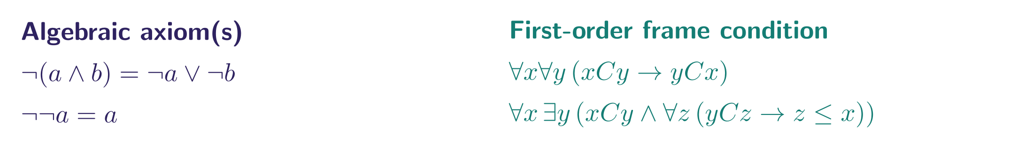
CHARACTERIZATION — DE MORGAN
De Morgan negation ↔ D-frames
The two D-frame conditions say precisely: C is symmetric, and every point has a unique “farthest compatible” point below its own predecessors — the algebraic seed of an involution.
TACL 2026

Slide 35
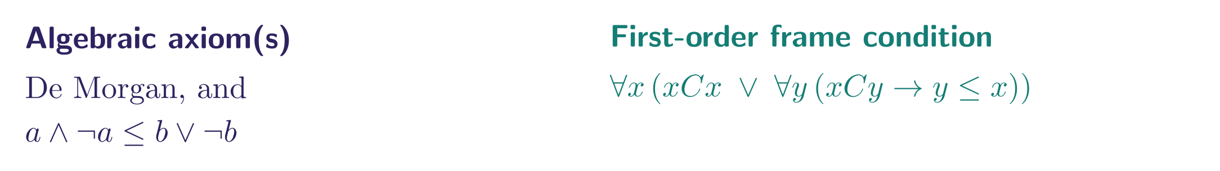
CHARACTERIZATION — KLEENE
Kleene negation ↔ Kleene frames
A Kleene frame is a D-frame where, additionally, every point is either C-compatible with itself or dominates everything it is compatible with.
TACL 2026

Slide 36
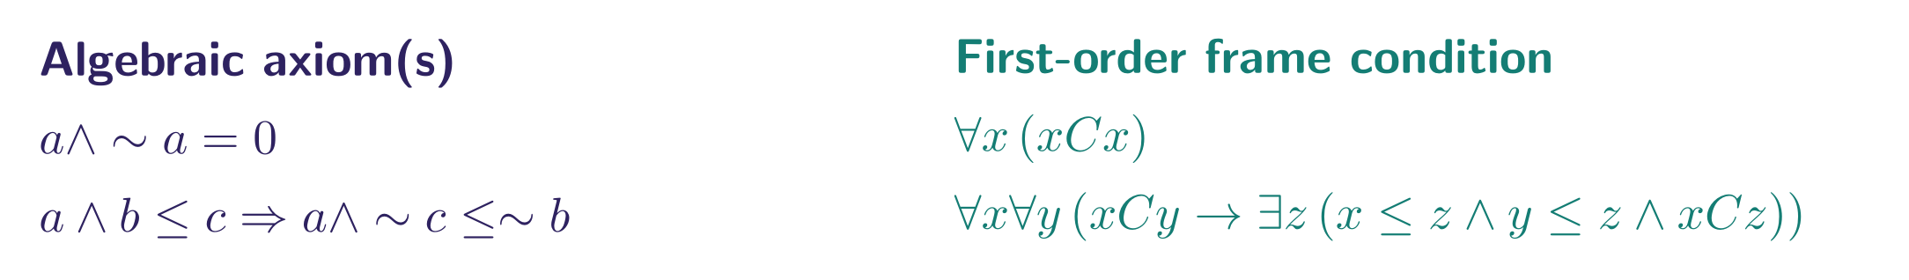
CHARACTERIZATION — PSEUDOCOMPLEMENTED
Pseudocomplement ↔ Pₛ-frames
Reflexivity of C plus a directedness condition recovers exactly the intuitionistic and Johansson-minimal axioms together.
TACL 2026

Slide 37
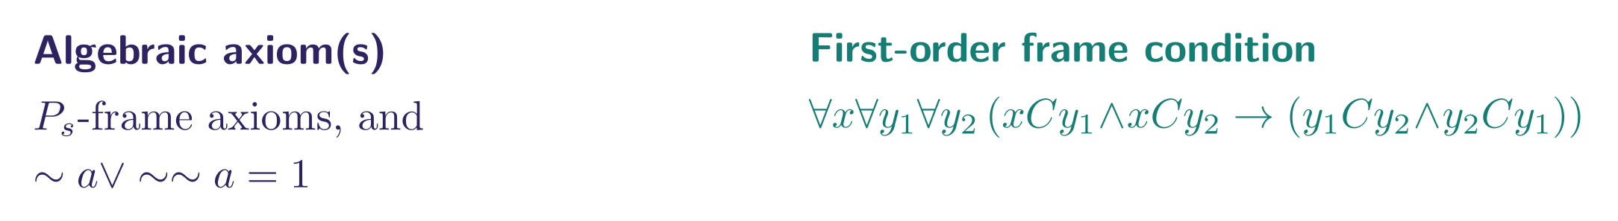
CHARACTERIZATION — STONE
Stone identity ↔ Stone frames
On top of a Pₛ-frame, forcing any two C-successors of a point to be mutually compatible pins down the Stone identity ∼a ∨ ∼∼a = 1.
TACL 2026

Slide 38
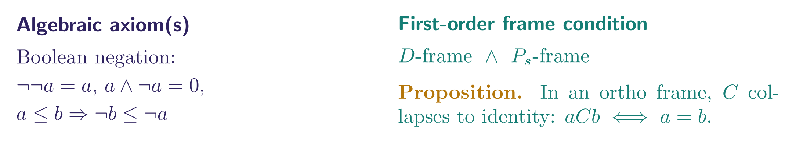
CHARACTERIZATION — ORTHO
Boolean negation ↔ Ortho frames
Ortho frames are simultaneously D-frames and Pₛ-frames — and this forces C to collapse onto the identity relation, recovering ordinary Stone duality for Boolean algebras as a special case.
TACL 2026

Slide 39
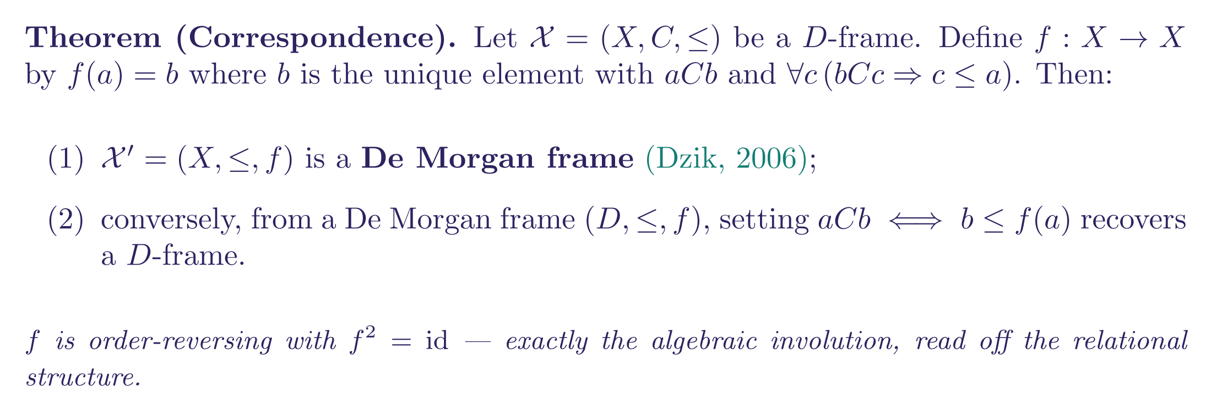
TYING IT BACK TO KNOWN DUALITY
D-frames recover Dzik’s De Morgan frames
TACL 2026

Slide 40
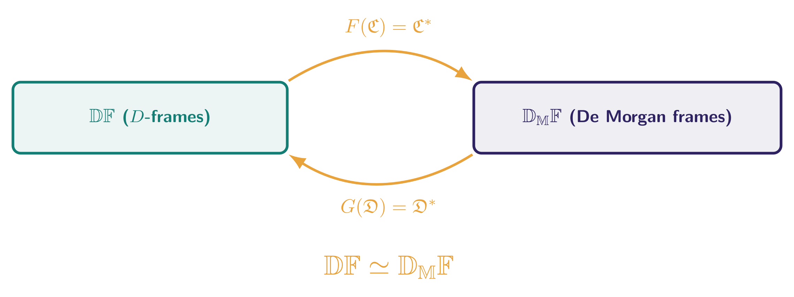
CATEGORICAL + TOPOLOGICAL PAYOFF
𝔻𝔽 ≃ De Morgan frames, functorially
Topological version: D-spaces (Celani-style topologized D-frames) correspond to Cornish’s De Morgan spaces exactly as the discrete frames do — the correspondence carries the topology along unchanged.
TACL 2026

Slide 41
05
Conclusion
One relational vocabulary, one functorial recipe, and a whole hierarchy of negations.

Slide 42
SUMMARY
Conclusions
Partial bounded morphisms:
the correct structure-preserving maps between compatibility frames — relational, not merely functional, in the back condition.
TACL 2026

Slide 43
SUMMARY
Conclusions
Partial bounded morphisms:
the correct structure-preserving maps between compatibility frames — relational, not merely functional, in the back condition.
A genuine dual equivalence:
𝔻_𝔽 ≃ 𝕂_𝕀^op between descriptive compatibility frames and Kᵢ-algebras, extending the earlier discrete duality.
TACL 2026

Slide 44
SUMMARY
Conclusions
Partial bounded morphisms:
the correct structure-preserving maps between compatibility frames — relational, not merely functional, in the back condition.
A genuine dual equivalence:
𝔻_𝔽 ≃ 𝕂_𝕀^op between descriptive compatibility frames and Kᵢ-algebras, extending the earlier discrete duality.
Compatibility with Celani’s ¬-spaces:
situating the new duality inside established duality theory for distributive lattices with negation.
TACL 2026

Slide 45
SUMMARY
Conclusions
Partial bounded morphisms:
the correct structure-preserving maps between compatibility frames — relational, not merely functional, in the back condition.
A genuine dual equivalence:
𝔻_𝔽 ≃ 𝕂_𝕀^op between descriptive compatibility frames and Kᵢ-algebras, extending the earlier discrete duality.
Compatibility with Celani’s ¬-spaces:
situating the new duality inside established duality theory for distributive lattices with negation.
First-order characterizations:
explicit frame conditions pinning down De Morgan, Kleene, pseudocomplemented, Stone and ortho negation within one relational vocabulary.
TACL 2026

Slide 46
SUMMARY
Conclusions
Partial bounded morphisms:
the correct structure-preserving maps between compatibility frames — relational, not merely functional, in the back condition.
A genuine dual equivalence:
𝔻_𝔽 ≃ 𝕂_𝕀^op between descriptive compatibility frames and Kᵢ-algebras, extending the earlier discrete duality.
Compatibility with Celani’s ¬-spaces:
situating the new duality inside established duality theory for distributive lattices with negation.
First-order characterizations:
explicit frame conditions pinning down De Morgan, Kleene, pseudocomplemented, Stone and ortho negation within one relational vocabulary.
Extension along Dunn’s kite:
to exhaustive frames / Kᵤ-algebras and K₋ frames / K₋-algebras, reaching regular double Stone algebras as well.
TACL 2026

Slide 47
BIBLIOGRAPHY
Main references
[1] A. Kumar, N. Gaur, B. Dewan. A categorical analysis of compatibility frames. Journal of Logic and Computation, 35(4), 2025.
[2] P. Blackburn, M. de Rijke, Y. Venema. Modal Logic. Cambridge University Press, 2001.
[3] S. A. Celani. Distributive lattices with a negation operator. Mathematical Logic Quarterly, 45(2):199–216, 1999.
[4] W. H. Cornish, P. Fowler. Coproducts of De Morgan algebras. Bull. Aust. Math. Soc., 16(1):1–13, 1977.
[5] J. M. Dunn. Star and perp: Two treatments of negation. Philosophical Perspectives, 7:331–357, 1993.
TACL 2026

Slide 48
BIBLIOGRAPHY
Main references
[1] A. Kumar, N. Gaur, B. Dewan. A categorical analysis of compatibility frames. Journal of Logic and Computation, 35(4), 2025.
[2] P. Blackburn, M. de Rijke, Y. Venema. Modal Logic. Cambridge University Press, 2001.
[3] S. A. Celani. Distributive lattices with a negation operator. Mathematical Logic Quarterly, 45(2):199–216, 1999.
[4] W. H. Cornish, P. Fowler. Coproducts of De Morgan algebras. Bull. Aust. Math. Soc., 16(1):1–13, 1977.
[5] J. M. Dunn. Star and perp: Two treatments of negation. Philosophical Perspectives, 7:331–357, 1993.
[6] J. M. Dunn. Generalized Galois logics: Completeness and classicality. In Logic at Work, pp. 3–32. Springer, 1996.
[7] M. Gehrke, S. van Gool. Topological Duality for Distributive Lattices: Theory and Applications. Cambridge University Press, 2024.
[8] A. Kumar, M. Banerjee. Kleene algebras and logic: Boolean and rough set representations, 3-valued, rough set and perp semantics. Studia Logica, 105(3):439–469, 2017.
[9] Y. Shramko. Negation in the context of gaggle theory. Studia Logica, 80(2–3):235–264, 2005.
[10] V. Sofronie-Stokkermans. Duality and canonical extensions of bounded distributive lattices with operators… I. Studia Logica, 64(1):93–132, 2000.
TACL 2026

Slide 49
Thank you
Questions and discussion welcome.
Neha Gaur
gaur.neha1947@gmail.com
Computer Science Unit, Indian Statistical Institute, Chennai centre, India

